Slide 1
Our First Data Structures:
Queues

Slide 2
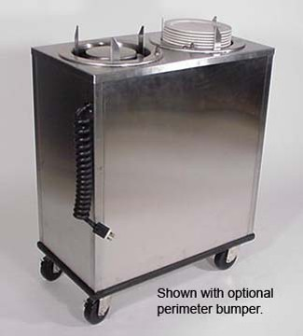
Stacks

Slide 3
Stack<T>
Stack - First Come, Last Served; less common in real life, but often in programing such as for a recursion, call stack or parsing grammars; does not allow random access (no line jumping!)
Class like a dinner plate device in a cafeteria, push the plates down, pop the top one
Objects enter the stack at the top
Objects are removed from the top of the stack
LIFO data structure - Last In First Out

Slide 4
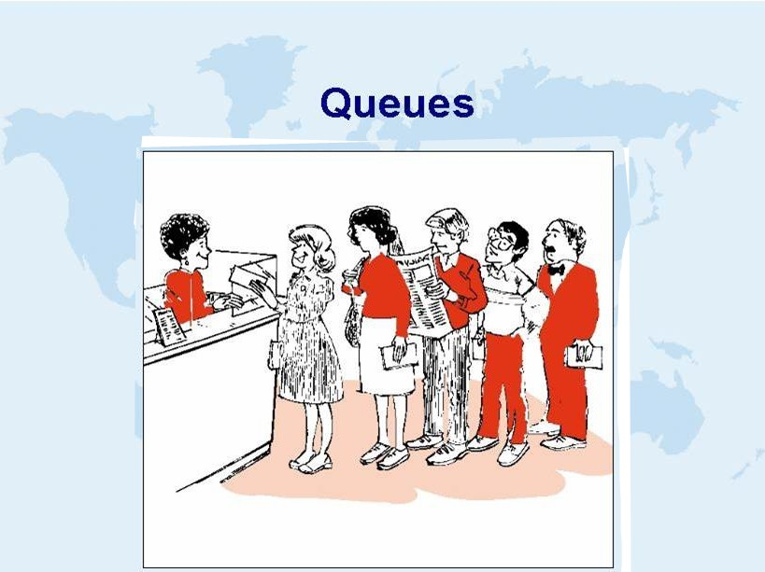

Slide 5
Queue<T>
Queue – First In, First Out; adding and removing items to a buffer in first come, first served order ; but does not allow random access (no line jumping!)
Class that behaves like a line at the bank
Holds multiple objects
Objects enter the queue at the bottom
Objects are removed from the top of the queue
FIFO data structure - First In First Out

Slide 6
Used in cases wherein items need to be serviced in the order in which they arrive
GUI event systems
DB transactions
Asynchronous processes on same or different machines to communicate. (email vs telephone)
Ex: App accepts ads for Craig’s List, takes 3 minutes to process and post
App1
App2
Cust Places ad | New Q depth | Ad Processed
2:01 | 1 | 2:04
2:02 | 2 | 2:07
2:02 | 3 | 2:10
2:08 | 2 | 2:13
2:20 | 1 | 2:23
2:21 | 2 | 2:26
2:23 | 3 | 2:29

Slide 7
Watch animation: http://www.cs.usfca.edu/~galles/visualization/QueueArray.html
Next, Our Queue Class Specification (API)
loosely based on the .Net Stack class
From Mike’s course
One property Qcount
and 5 methods

Slide 8
5 Queue. methods
void Enqueue(int newItem)
If the queue is not full, add item to the back/rear of the queue.
If the queue is full, an overflow error has occurred, and an OverflowException is thrown
int Dequeue()
If the queue is not empty, then the front item is removed & returned.
If the queue is empty, then an underflow error has occurred, and an IndexOutOfRangeException is thrown
int Peek()
If the queue is not empty, then the front item is returned via the out parameter. The queue itself is unchanged
If the queue is empty, then an IndexOutOfRangeException is thrown
bool IsEmpty()
If the queue is empty, then true is returned. Otherwise, returns false.
void Clear()
Effectively removes all data (by just changing the pointers and count)
(.Net does not have a UnderflowException ?)

Slide 9
Considerations
How do we store our queue items?
How many can we store?
How do we access the “top” whatever, wherever that is?
The “bottom”?

Slide 10
Our Queue Class Implementation
Declare variables to keep track of
An array of integers to store the contents of the queue (could be a queue of other types if wanted)
An integer, a pointer, to keep track of the index of the ‘top’ of the queue
An integer, another pointer, to keep track of the index of the ‘bottom’ of the queue
An integer to keep track how many entries are in the Q

Slide 11
Problem
If we use an array, and add items and remove items, our queue values will keep sliding down, leaving empty space at the top.
add add add remove remove add
A | A | A
 | B | B | B
 |  | C | C | C | C
 |  |  |  |  | D

Slide 12
Solutions
Every time an item is dequeued, copy all the remaining data up one spot. If queue is big, this is a CPU expensive solution
Better, implement a circular queue
Keep a pointer for the top and bottom
When bottom pointer = size-1, add the item and move the pointer back to 0 (if there is space).

Slide 13
Circular Queue
tp = top pointer bp = bottom pointer
0
1
2
3
 | A | A | A |  |  |  | E
 |  | B | B | B
 |  |  | C | C | C | C | C
 |  |  |  |  |  | D | D
tp = 0
bp = 0
tp = 0
bp = 1
tp = 0
bp = 2
tp = 0
bp = 3
tp = 1
bp = 3
tp = 2
bp = 3
tp = 2
bp = 0
tp = 2
bp = 1

Slide 14
Lets look at the code
Unzip and open: OurQueueClass.zip

Slide 15
Our variables to support the queue
private int qTop;
private int qBottom;
// is really a pointer to the next unused slot in the array
int [] ourData; // underlying array to hold the data
private int counter; // our field to keep track of how many
public int QCount // simple property to expose number in queue
{
get { return counter; }
// set do not let outside program change this value
}

Slide 16
constructor
public OurQueue (int qSize) // constructor, allow user to
pick a reasonable upper limit for size
{
ourData = new int[qSize]; // set the size of the array
qTop = 0; // next one to take out -->
value makes no sense as queue is empty
qBottom = 0; // next unused is top of array
counter = 0; // zero makes sense
}

Slide 17
Enqueue
public void Enqueue(int newItem)
{
if (counter >= ourData.Length) // make sure we have room
{
throw new OverflowException("Q is full");
}
counter++; // adding one, so up the count on entries
ourData[qBottom] = newItem; // put it where our bottom is
// if we have to wrap around back to the lowest value in array
if ((qBottom + 1) == ourData.Length)
{
qBottom = 0; // just set bottom back to 0. We KNOW we have room
}
else
{
qBottom = qBottom + 1; // otherwise, just bump it one
}
}

Slide 18
Dequeue
public int Dequeue()
{
if (counter == 0) // make sure there is something to return
{
throw new IndexOutOfRangeException("Q is empty");
// again, there is no "underflow" exception, so using this one
}
int returnValue = ourData[qTop]; // use our pointer to find it
counter--; // one less, so adjust count
// do we need to wrap?
if ((qTop + 1) == ourData.Length)
{
qTop = 0; // yes we do, so move back to the low value of the array
}
else
{
qTop = qTop + 1; // else just bump it 1
}
return returnValue;
}

Slide 19
IsEmpty
public bool IsEmpty()
{
if (counter == 0) // just check the count
{
return true;
}
else
{
return false;
}
}

Slide 20
Peek and Clear
public int Peek()
{
if (counter == 0)
{
throw new IndexOutOfRangeException("Q is empty");
}
else
{
return ourData[qTop];
}
}
public void Clear()
{
qTop = 0;
qBottom = 0;
counter = 0;
}

Slide 21
Queue Tests From Console Program
Test 1: fill the Q, then add and remove until counters have wrapped completely around back to 0
Test 2: test that .Clear does clear the Q
Test 3: test values are correct after looping the pointers.
Test 4: make sure queue is storing data correctly
Test 5: check that we throw the correct exception when trying to pop an empty Q
Test 6: check that we throw the correct exception when we try to put an entry in when the queue is already full
Test 7: check that we throw the correct exception when we try to peek at an empty queue

Slide 22
Some other test ideas
Check if peak 2 times gives correct value
Test that peek and dequeue return the same value if done in that order
Enqueue and dequeue at same location several times, different value
Setting the size of the queue to 0 and then trying to enqueue an element
Shouldn't be able to make a queue with a negative size
Enqueue very large numbers, negative numbers

